Slide 1
Manjunath Reddy Edla Jagadeeshwar Reddy Gaddam Hareen Edla Surendar Gaddam Sai Charan Reddy Enukonda Smart Hiring Analytics School of Professional Studies, Saint Louis University IS-5960-02 Master’s Research Project Prof. Maria Weber May 01, 2025

Slide 2
Project Description
This project analyzes job market data for Data Scientist roles using a dataset sourced from Glassdoor. The raw data was cleaned using Python, structured using an ERD in MySQL, and visualized through Power BI. The dashboard offers real-time insights into salary trends, skill demand, company hiring patterns, and job distribution by location and sector. It serves as a decision-support tool for both HR professionals and job seekers.
🧑‍💼 Intended Users:
HR Managers & Recruiters hiring for data science roles
Job Seekers in the data science domain are aiming to align their skills with market demand.
💡 Thought Process:
By analyzing the final dashboard insights, such as high-paying companies, in-demand skills, job trends by state, and company ratings, it was evident that HRs and aspiring data scientists could leverage this tool. The dashboard provides strategic recruitment intelligence for HRs and actionable career guidance for candidates.

Slide 3
Decision-Making Needs of the User
Strategic Workforce Planning
HR managers need to forecast hiring demands and budget salaries based on market trends.
Recruiters are responsible for sourcing candidates with relevant, in-demand skills aligned with current job market needs.
Candidate Market Insights (for job seekers)
Job seekers must understand which roles, skills, and companies offer the most opportunities and competitive compensation.
How the Application Supports Their Decisions:
Identifies top hiring regions and companies by job volume.
Displays salary benchmarks and rating comparisons.
Highlights high-demand skills across job titles and industries.
Reveals which skills to prioritize learning for Data Scientist roles.

Slide 4
Key Features
Focused on Data Scientist role insights
Real-time salary analysis by state and industry
Identifies top hiring companies and regions
Interactive filters: Location, Industry, Company Size
Built using Power BI with clean, responsive visuals

Slide 5
Data Validation and Preparation
We have examined the raw dataset from Glassdoor and identified columns that were most relevant for:
Salary analysis
Skill demand trends
Location-based jobs
Company comparison metrics
Used Python (Pandas) to:
Identify and remove duplicate entries
Handle null values by replacing or dropping based on field relevance (e.g., filled missing Industry based on similar records)
Standardize date formats and skill strings
Used MySQL to validate:
Primary key constraints
Foreign key integrity across linked fields (e.g., Company ↔ Job ↔ Location)

Slide 6
Data Transformation / New Computations:
Skills:
Extracted the Skills from the Job Description using the Regex function in Python and created a new column named extracted skills.
Date Fields:
Extracted Month Year from the Posted Date for time-based trend analysis.
Aggregates:
Computed Average Salary, Job Count, and Rating Distribution per sector, company, and skill group using DAX measures.
Categorization:
Grouped the Salary Estimate into ranges (e.g., <60K, 60K–100K, 100 K+) for easier visual representation.

Slide 7
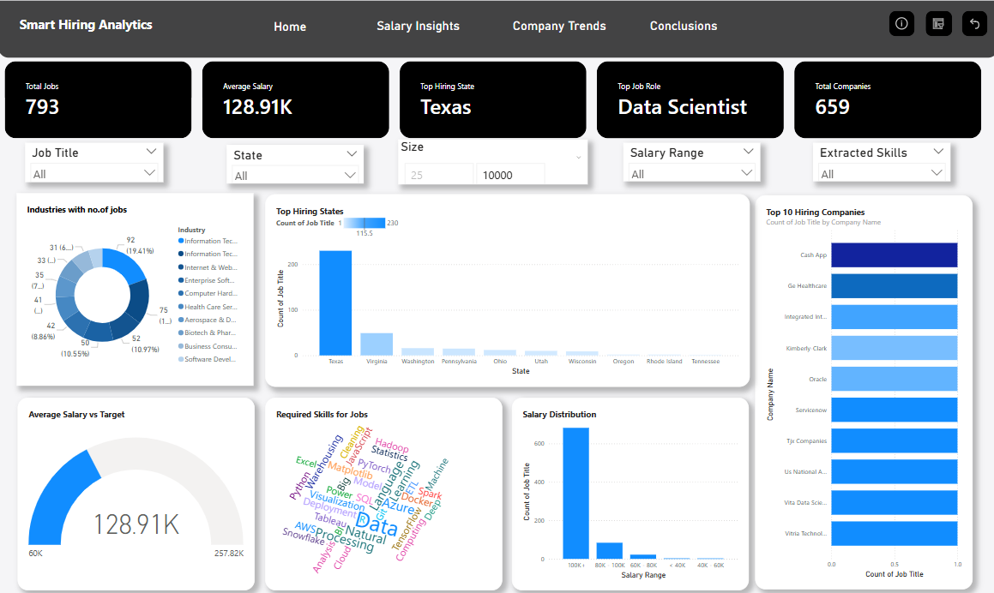
Design of User Interface:

Slide 8
Challenges
Data Cleaning & Preparation:The Glassdoor dataset was raw and messy it had missing values, inconsistent formats, and did not have specific columns which are required for analysis.
Data Validation
Ensuring that the cleaned data loaded into MySQL retained referential integrity (especially when designing the ERD).
Verifying that each field was usable in visuals without introducing inaccuracies particularly with salary, location, and skill data.
Dashboard Design: Ensuring that interactive elements (filters, slicers, tooltips) were meaningful and did not confuse users with information.
Technical Integration
Managing the transition from Python (for cleaning) to MySQL (for modeling) to Power BI (for visualization) without data loss.
Creating a flexible data model that allowed quick refresh and testing without breaking relationships or visuals.

Slide 9
How we Overcame the Challenges
Data Cleaning
Used Python (Pandas, Regex) to clean the dataset:
Removed duplicates
Standardized text and date formats
Filled or handled missing values logically (e.g., based on similar companies or job roles).
Data Validation
Designed an ERD(Entity Relationship Diagram) in MySQL to logically organize entities (Company, Job, Location).
Ensured primary and foreign key relationships were valid before loading to Power BI.
Dashboard Design & Logic
Created separate dashboard sections/tabs tailored to each user (e.g., company trends for HRs, skill analysis for job seekers)
Used Power BI slicers and tooltips to maintain interactivity while keeping visuals focused and clean
Technical Integration
Carefully exported cleaned data from Python into MySQL, maintaining column types and structure
Created a consistent data flow: Python → MySQL → Power BI
Tested refreshes and dashboard stability across multiple use cases before finalizing

Slide 10

Courses That Helped in This Project
Python Helped clean and preprocess unstructured job market data efficiently.
Database Management Systems (DBMS)
Enabled us to design the ERD, normalize data, and manage relational tables in MySQL.
Visualization, Feedback and Dissemination(Power BI)
Provided the skills to build insightful, interactive dashboards aligned with user decision-making needs.
Applied Analytics
Supported metric interpretation, visual summaries, and trend identification in the dataset.

Slide 11
Reflection
Defining and Refining the Project Charter
Initially, the project idea was focused on analyzing job market data. However, through iteration, it evolved into a decision-support tool tailored for both HR professionals and job seekers. We learned the importance of aligning the problem statement with real user needs and continuously refining the scope as new insights emerged from the data.
Acquiring Domain Knowledge
Since HR analytics and job market analysis were new domains. We took a research approach:
Studied job trends on platforms like Glassdoor and LinkedIn.
Applied the knowledge from Visualization, Feedback, and Dissemination to create a dashboard in Power BI.
What didn’t work: Initially, we thought of web scraping, but it did not work out because the data was not clear to create dashboards, and it needed significant cleaning before it was usable.
What We Learned
We came to know that working with the datasets and creating interactive dashboards is important for data-driven decision making, and technically, how data is cleaned and transformed.
Moreover, working with a team, we learnt how flexible one needs to be in a team setting.
Future Applications
Clear scoping and user-centered design for all future projects.
Agile, iterative thinking when tackling data challenges.

Slide 12
Thank You

